Slide 1
Ecommerce Project
Understanding Total Price of Cart Products

Slide 2
Introduction
This presentation focuses on the cart's critical role in ecommerce, with a specific emphasis on calculating the total price of products within a shopping cart. We will explore the components of a shopping cart, pricing methods, and the significance of cart management in ecommerce success.

Slide 3
01
Cart Overview

Slide 4
Definition of Cart Products
Cart products refer to the items selected by customers for purchase within an online store. Each product in the cart includes key details such as the product name, price, quantity, and any customization options. The cart serves as a temporary holding space before checkout, allowing customers to review and adjust their selections.

Slide 5
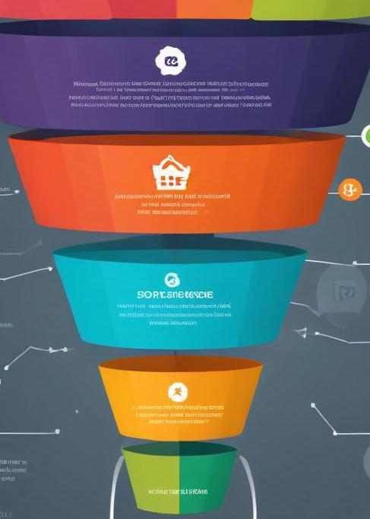
Importance of Cart in Ecommerce
The shopping cart is a vital component of any ecommerce platform, acting as a bridge between product selection and purchase. It enhances user experience by allowing customers to compile items they wish to buy, offers a clear view of total costs, and facilitates easy modifications to the order. Efficient cart management can lead to increased conversion rates and customer satisfaction.

Slide 6
Components of a Shopping Cart
A shopping cart comprises several key components that enhance the customer experience. These include the product list, which displays all items selected for purchase with details like names, images, and prices. The cart also features quantity selectors for easy adjustments, a total price display that updates in real-time, and options for applying coupons or discounts. Finally, it includes a checkout button that guides customers to the payment process, ensuring a smooth transition from selection to purchase.

Slide 7
02
Total Price Calculation

Slide 8
Pricing of Individual Products
Pricing of individual products is fundamental for determining the total cost in a shopping cart. Each item's price may be influenced by factors such as manufacturer pricing, current market trends, and competitive analysis. It is essential to display clear pricing for customers, including any retail or promotional price reductions, to help them make informed decisions. Additionally, the presentation of price breakdowns, including any dependencies on selected quantities, adds to transparency and builds trust.

Slide 9

Handling Discounts and Promotions
Discounts and promotions play a crucial role in enhancing customer interest and incentivizing purchases. There are several methods for applying discounts within a shopping cart, including percentage-based reductions, fixed dollar off discounts, or buy-one-get-one offers. It is vital to explicitly communicate discount terms to customers, such as minimum purchase requirements or expiry dates. An effective promotional strategy can lead to increased sales volume and customer loyalty.

Slide 10
Tax and Shipping Considerations
Calculating taxes and shipping costs is integral to providing customers with an accurate total price in their shopping cart. Taxes may vary depending on geographic location, product type, and current regulations, so it's essential to include these calculations automatically within the cart. Shipping costs can also fluctuate based on factors such as delivery method, order weight, or promotional shipping offers. Clearly outlining these charges ensures transparency and can affect the final purchasing decision of the customer.

Slide 11
Conclusions
The shopping cart serves as a pivotal element in the ecommerce journey, where effective management of product selection and total price calculation can significantly impact customer satisfaction and conversion rates. Understanding the components of a cart, alongside the methodologies for calculating total price, including pricing strategies, discounts, taxes, and shipping, empowers businesses to create an optimal online shopping experience.

